Slide 1
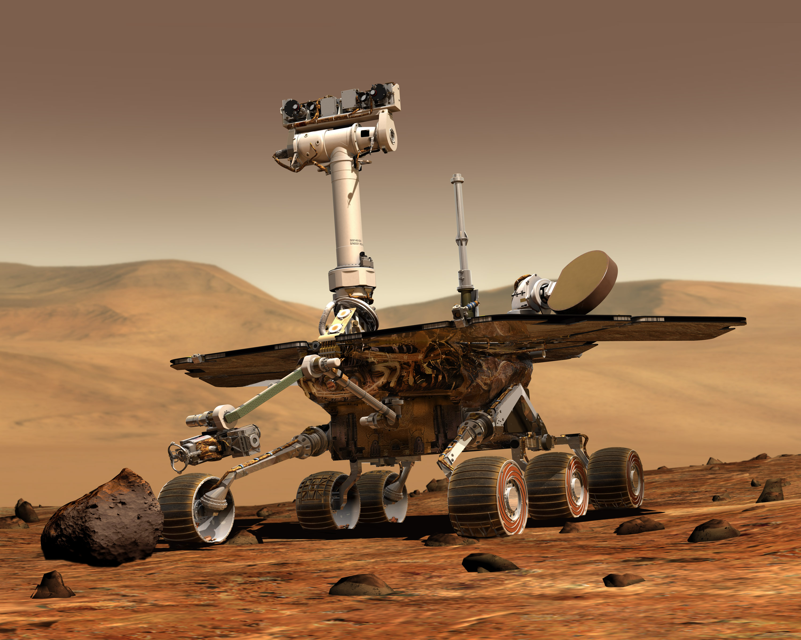



Ergo-Tech Approach
Behnam Rasoolian
Rong Huangfu
Bob Granzow
Mengdie Chen
Setup server on Raspberry Pi
Host website and database
Developed MySQL database
For a given rover and camera, what dates have images (and quantity)
URL of 1st image to be used as preview
This is used to identify the dates that images are available for given rover and camera
Eliminates unnecessary query time for cameras or dates that have no images
Developed user interface (Python, PyQt)
Choose rover, choose camera, choose date (from available)
Displays pictures

